Slide 1
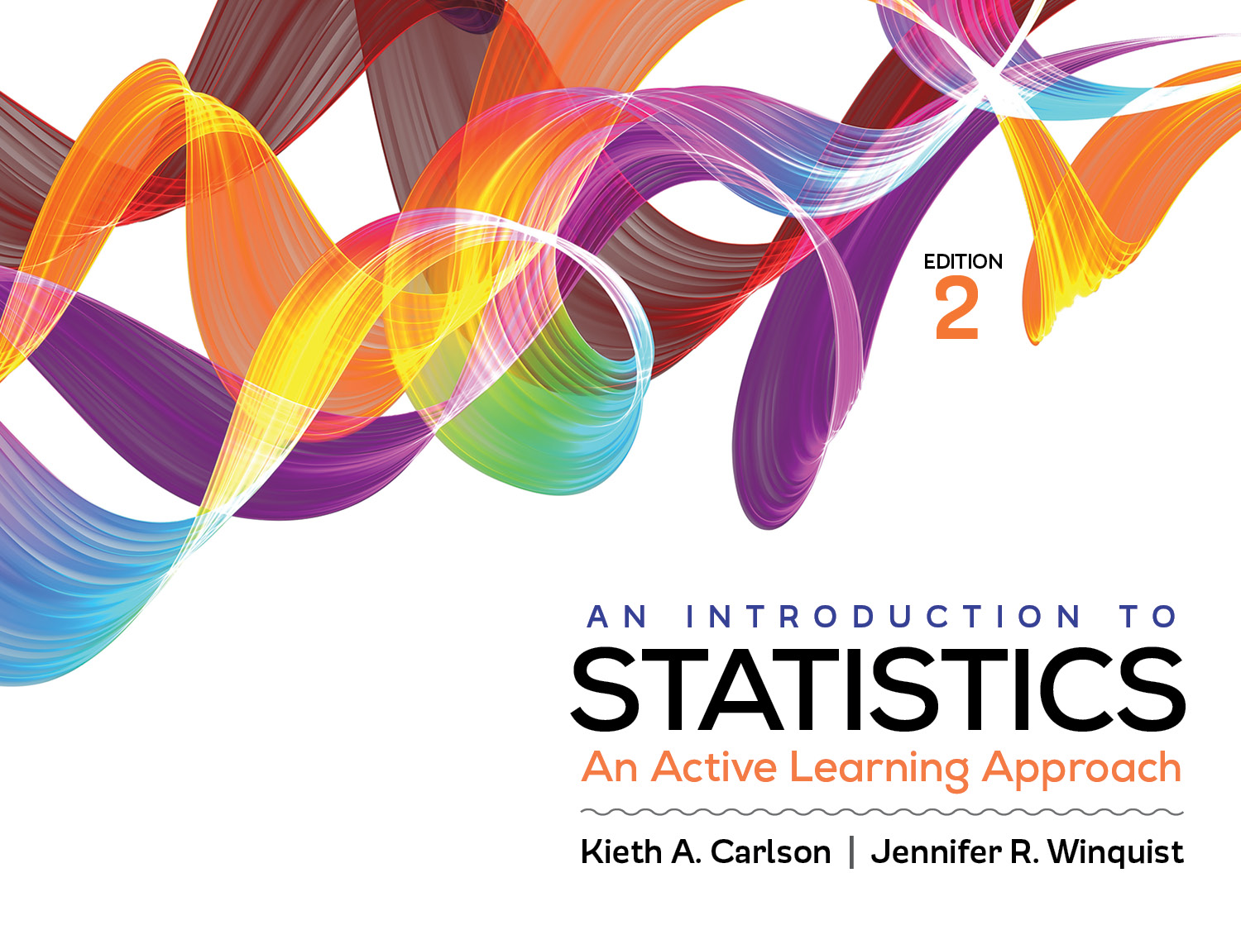
Introduction to Activity 11.6
How to Choose the Correct Statistic

Slide 2
Activity 11.6 will require you to:
Choose the correct significance test for a given scenario
If necessary use Appendix J to help you

Slide 3
Which significance test and why? 1- or 2-tailed?
Is the mean test score of a group of 9th graders higher than that of a group of 12th graders?
Is this class of students’ scores better now than it was 1 month ago?
Is socio-economic status (i.e., below average, average, and above average) associated with happiness score?
Is the anxiety score of a sample of yoga instructors lower than the national average?
Notes:
Independent t test
Repeated t test
Oneway ANOVA
Single sample t test or z for a sample mean (depending of whether you know the population standard deviation)

